Slide 1

HISTORY OF THE EMERGENCE OF INDEPENDENT BANGLADESH
Dr. Md. Abdul Alim
B. A (Hon’s), M. A (History), M. Phil (Raj), Ph. D (Raj)
Email:doctorabdulalim64@gmail.com
Cell: +88001718787466

Slide 2
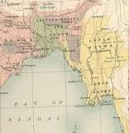
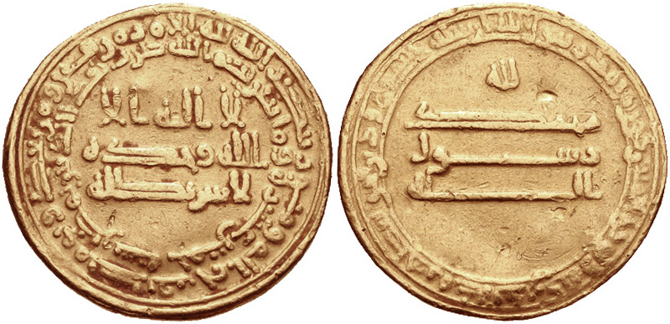
RISE OF ISLAM
There is no denying the fact that political Islam first set foot on the soil of Gaud, Pundra and Lakhnawati with the victorious Turkish army led by Ikhtiyar al-Din Muhammad bin Bakhtiyar Khalji in 1204 AD. But that does not mean there was no communication or contact between the people of Arabia, Persia, Afghanistan with the Bengal prior to the Ikhtiyar’s conquest. In fact, coins issued by Abbasi Caliphs have been discovered in Paharpur is dated 788 AD when the great Harun-al-Rashid was the Caliph in Baghdad. The coin found in Mainamati was issued by the Abbasi Caliph Muntasir Billah who ruled the Muslim world in 861 AD.

Slide 3
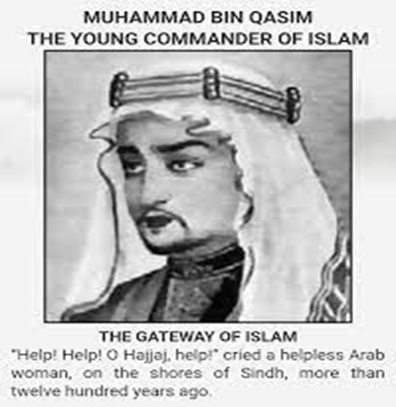
RISE OF ISLAM
It should be noted that Arab general Muhammad Ibn Qasim conquered Sind in 714 AD nearly four centuries before Bakhtiyar Khalji marched practically unopposed to Nadia, the then temporary capital of Lakshmana Sena, the last ruler of the Sena dynasty.
According to tradition, the first such settlement resulted from the capsizing of Arabian ships due to a cyclonic storm along Chittagong-Cox’s Bazar coastal belt. It is highly probable that some Arab preachers and Sufis had also travelled to this part of the subcontinent long before the Turkish military expedition of the early 13th century.
Touching on the issue, Dr. Nihar Ranjan Roy writes in his Bangalir Itihas: “Few examples can be given where people have arrived in Bangladesh from outside India. Some Arab Muslim families came to Bangladesh for commercial purpose and then settled here. People of such origin in small numbers can be found in Noakhali-Chittagong and other districts of Bengal. During a long cycle of centuries, they have merged with indigenous people through association and intercourse.

Slide 4
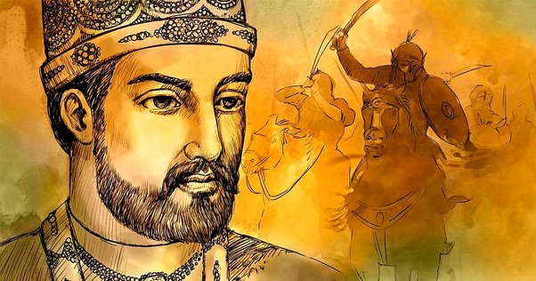
RISE OF ISLAM
It is beyond doubt that the Arab Muslims travelled to the coastal regions of Bangladesh during the early days of Islam as part of their global commercial activities. It is also not unlikely that some of them might have settled in the long coastal belt from Noakhali to Cox’s Bazar. There are popular stories in the Arakan region that the Arab Muslims had been established on both sides of Myanmar and Bangladesh since ancient times.
However, the conquest of Ikhtiyar Khalji definitely, paved the way for the Sufis to arrive in greater numbers from Arabia and Persia. Readers should bear in mind that at that time this part of the subcontinent was not very hospitable due to its deltaic geographical configuration, huge rivers and dense forests. Before narrating the story of the further spread of Islam, a short summary of the social conditions and cultural geography existing at the time is needed to assist the readers in understanding the extraordinary transformation of faith among the indigenous peoples of the delta.

Slide 5
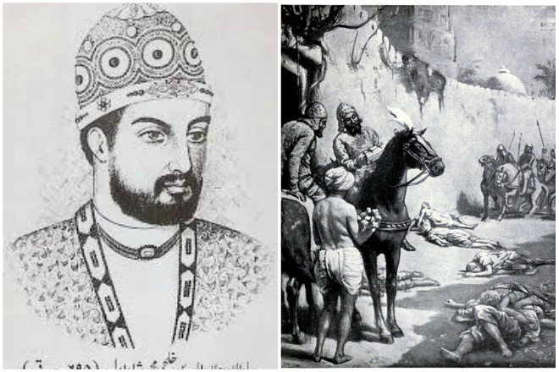
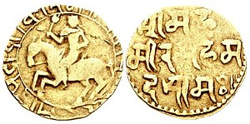
BENGAL SULTANATE - IKHTIYAR UDDIN MUHAMMAD BIN BAKHTIYAR KHILJI
Ikhtiyar Uddin Muhammad bin Bakhtiyar Khilji, a member of the Khilji tribe, a Turkic tribe long settled in what is now southern Afghanistan, was head of the military force that conquered much of eastern India at the end of the 12th Century. Khilji came from the town of Garmsir in southern Afghanistan. Tradition has it that Khilji's conquest of Bengal at the head of 18 horsemen. It is reported that he had long arms extending below his knees entered the army of Qutb-al-Din, but was refused rank. Then he went further eastward and took a job under Maklik Hizbar al-Din, then in command of a platoon at Badayun in northern India. After a short period, he went to Oudh where Malik Husam al-Din, recognized him for his worth. Husam gave him a landed estate in the south-eastern corner of the modern Mirzapur district. Khilji gathered some Muslims under his banner and soon consolidated his position, carrying out raids into neighboring territories

Slide 6
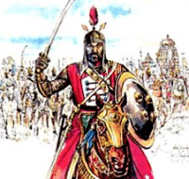
BENGAL SULTANATE - IKHTIYAR UDDIN MUHAMMAD BIN BAKHTIYAR KHILJI
In 1190s, Khilji was also responsible for the destruction of Nalanda University, which was an ancient Buddhist University in Bihar, India, nearby to the stronghold of Bihar. He apparently also massacred the students. The main Persian source for this explains Khilji attacked the fortress unaware that it was a University Khilji’s career took right with a campaign which subjugated Bihar in 1203. This effort earned him political clout in the court at Delhi. In the same year he took his forces into Bengal. As he came upon the city of Nabadwip, it is said that he advanced so rapidly that only 18 horsemen from his army could keep up. Khilji went on to capture the capital Gaur and intruded into much of Bengal.
Ikhtiyar Khilji left the town of Devkot in 1206 to attack into Tibet, leaving Ali Mardan Khilji in Ghoraghat (under Dinajpur) to watch the eastern frontier from his headquarters at Barisal. Khilji forces were ambushed in Assam and Ikhtiyar returned to Devkot with about one hundred surviving soldiers. Upon Ikhtiyar Khilji's return to India, while he was lying ill at Devkot, he was assassinated by Ali Mardan. Loyal troops under Muhammad Shiran Khilji avenged Ikhtiyar's death, imprisoning Ali Mardan. Ghiyas-ud-din Iwaz Khilji became the successor. Ali Mardan escaped and was made Governor of Bengal by Qutb-ud-din Aibak, but was killed in 1210. Ghiyas-ud-din again assumed power and proclaimed his independence.

Slide 7
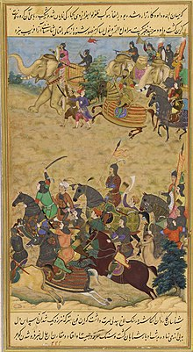
BENGAL SULTANATE
The Sultanate of Bengal was an empire based in Bengal for much of the 14th, 15th and 16th centuries. It was the dominant power of the Ganges–Brahmaputra Delta, with a network of mint towns spread across the region. The Bengal Sultanate had a circle of vassal states, including Odisha in the southwest, Arakan in the southeast, and Tripura in the east. It conquests reached Nepal in the north, Assam in the east, and Jaunpur and Varanasi in the west. The Bengal Sultanate controlled large parts of the northern, eastern and northeastern subcontinent during its five dynastic periods, reaching its peak under Hussain Shahi dynasty. It was reputed as a thriving trading nation and one of Asia's strongest states. Its decline by the Suri Empire, followed by Mughal conquest and disintegration into petty kingdoms. The Bengali Muslim, Assamese Muslim and Arakanese Muslim communities trace their history to the Bengal Sultanate.
The Bengal Sultanate was a Sunni Muslim monarchy with Turkic, Bengali, Arab, Abyssinian, Pashtun and Persian elites. Its two most prominent dynasties were the Ilyas Shahi and Hussain Shahi Sultans. The empire was known for its religious pluralism where non-Muslim communities co-existed peacefully. While Persian was used as the primary official, diplomatic and commercial language, it was under the Sultans that Bengali first received court recognition as an official language.

Slide 8
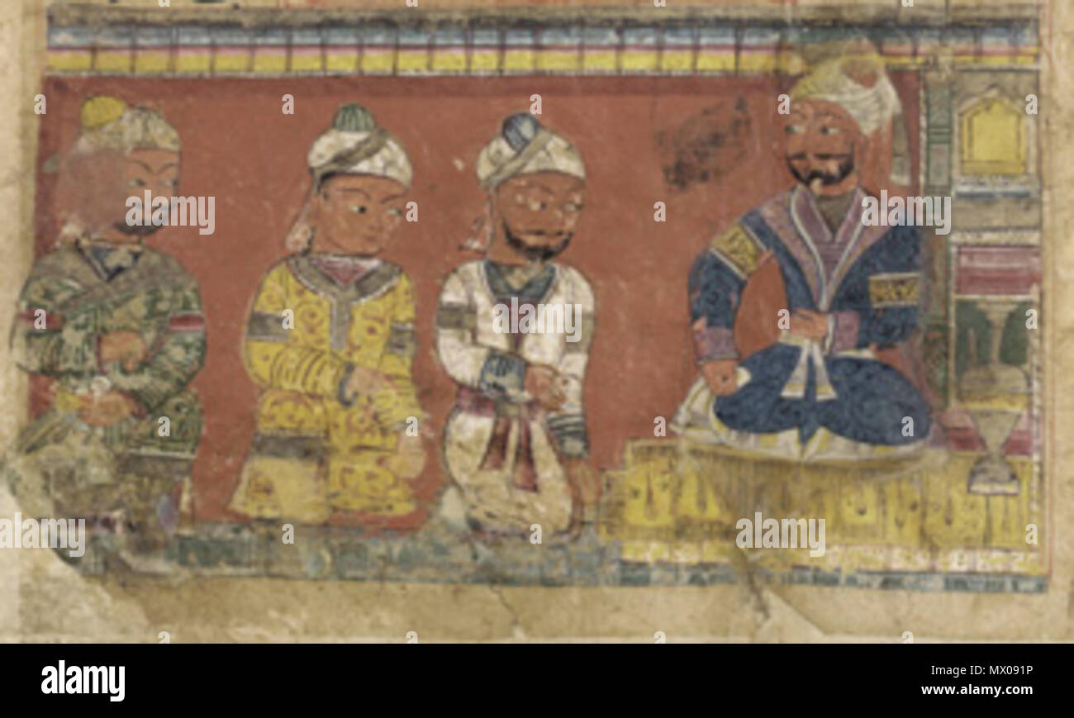
BENGAL SULTANATE
The cities of the Bengal Sultanate are termed as Mint Towns where the historical taka was minted. These cities were adorned with stately medieval buildings. In 1500, the royal capital of Gaur was the fifth-most populous city in the world. Other notable cities included the initial royal capital of Pandua, the economic hub of Sonargaon, the Mosque City of Bagerhat, and the seaport and trading hub of Chittagong.
The Bengal Sultanate was connected to states in Asia, Africa, the Indian Ocean, and Europe through maritime links and overland trade routes. The Bengal Sultanate was a major trading center on the coast of the Bay of Bengal. It attracted immigrants and traders from different parts of the world. Bengali ships and merchants traded across the region, including in Malacca, China, and the Maldives.
The Bengal Sultanate was described by contemporary European and Chinese visitors as a prosperous kingdom. Due to the abundance of goods in Bengal, the region was described as the "richest country to trade with". The Bengal Sultanate left a strong architectural legacy. Buildings from the period show foreign influences merged into a distinct Bengali style.

Slide 9
BENGAL SULTANATE - LIST OF DYNASTIES
Ilyas Shahi dynasty (1342–1435)
Name | Ruling Duration | Notes
Shamsuddin Ilyas Shah | 1342–1358 | Became the first sole ruler of whole Bengal comprising Sonargaon, Satgaon and Lakhnauti.
Sikandar Shah | 1358–1390 | Assassinated by his son and successor, Ghiyasuddin Azam Shah
Ghiyasuddin Azam Shah | 1390–1411
Saifuddin Hamza Shah | 1411–1413
Muhammad Shah bin Hamza Shah | 1413 | Assassinated by his father's slave Shihabuddin Bayazid Shah on the orders of the landlord of Dinajpur, Raja Ganesha
Shihabuddin Bayazid Shah | 1413–1414
Alauddin Firuz Shah I | 1414 | Son of Shihabuddin Bayazid Shah. Assassinated by Raja Ganesha

Slide 10
BENGAL SULTANATE - LIST OF DYNASTIES
Name | Ruling Duration | Notes
Jalaluddin Muhammad Shah | 1415–1416 | Son of Raja Ganesha and converted into Islam
Raja Ganesha | 1416–1418 | Second Phase
Jalaluddin Muhammad Shah | 1418–1433 | Second Phase
Shamsuddin Ahmad | 1433–1435

Slide 11
BENGAL SULTANATE - LIST OF DYNASTIES
Restored Ilyas Shahi dynasty (1435–1487)
Name | Ruling Duration | Notes
Nasiruddin Mahmud Shah I | 1435–1459
Rukunuddin Barbak Shah | 1459–1474
Shamsuddin Yusuf Shah | 1474–1481
Sikandar Shah II | 1481
Jalaluddin Fateh Shah | 1481–1487

Slide 12
BENGAL SULTANATE - LIST OF DYNASTIES
Habshi rule (1487–1494)
Name | Ruling Duration | Notes
Shahzada Barbak | 1487
Saifuddin Firuz Shah | 1487–1489
Mahmud Shah II | 1489–1490
Shamsuddin Muzaffar Shah | 1490–1494

Slide 13
BENGAL SULTANATE - LIST OF DYNASTIES
Hussain Shahi dynasty (1494–1538)
Name | Ruling Duration | Notes
Alauddin Hussain Shah | 1494–1518
Nasiruddin Nasrat Shah | 1518–1533
Alauddin Firuz Shah II | 1533
Ghiyasuddin Mahmud Shah | 1533–1538

Slide 14
BENGAL SULTANATE - LIST OF DYNASTIES
Governors under Suri rule (1539–1554)
Name | Ruling Duration | Notes
Khidr Khan | 1539–1541 | Declared independence in 1541 and was replaced
Qazi Fazilat | 1541–1545
Muhammad Khan Sur | 1545–1554 | Declared independence upon the death of Islam Shah Suri

Slide 15
BENGAL SULTANATE - LIST OF DYNASTIES
Muhammad Shah dynasty (1554–1564)
Name | Ruling Duration | Notes
Muhammad Khan Sur | 1554–1555 | Declared independence and styled himself as Shamsuddin Muhammad Shah
Ghiyasuddin Bahadur Shah II | 1555–1561
Ghiyasuddin Jalal Shah | 1561–1563
Ghiyasuddin Bahadur Shah III | 1563–1564

Slide 16
BENGAL SULTANATE - LIST OF DYNASTIES
Karrani dynasty (1564–1576)
Name | Ruling Duration | Notes
Taj Khan Karrani
Sulaiman Khan Karrani | 1566–1572
Bayazid Khan Karrani | 1572
Daud Khan Karrani | 1572–1576

Slide 17
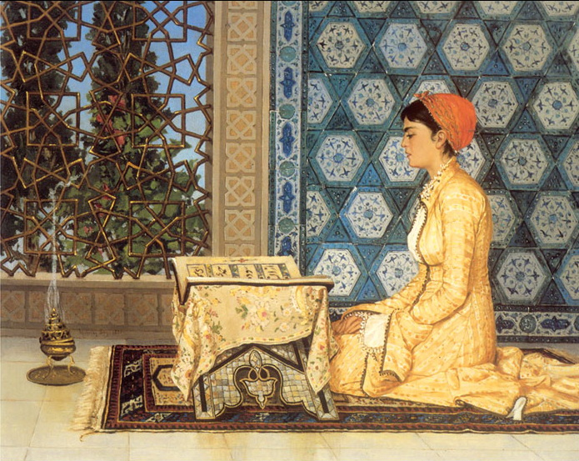
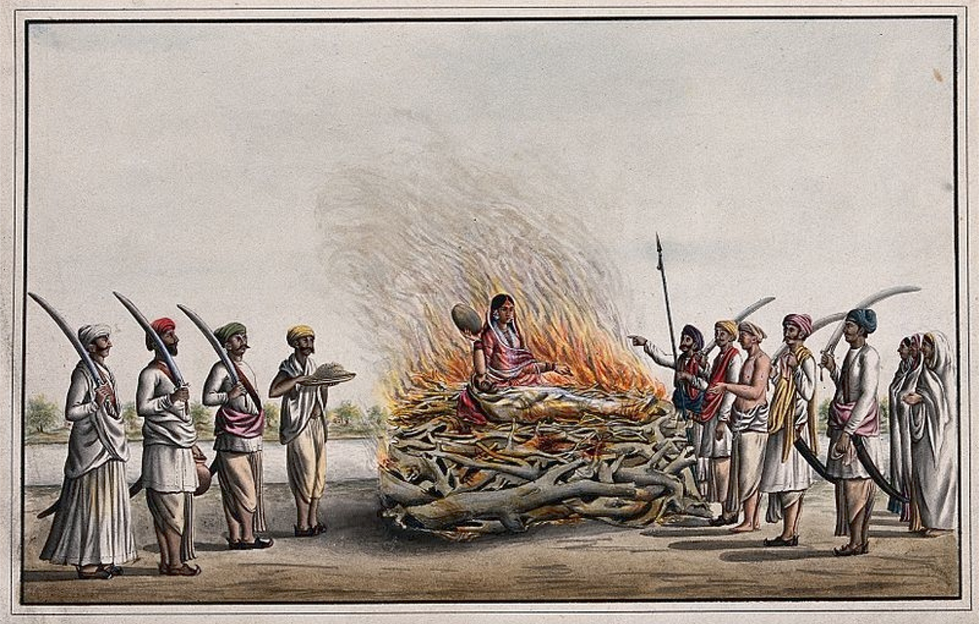
SOCIAL INFLUENCE IN MEDIEVAL BENGAL
Religion has played a vital role in the social system of Bengal since ancient times, and religion was the central element in building the social system. As a result, religious influences were visible in every sphere of Bengali life. The Role of Muslims in the Socio-Cultural Formation of Bengal during the Sultanate Period. The Muslim rule descent initiated a multi-faceted change in the social system of Bengal. Islam commands the protection of the rights of all people, which Muslims tried to protect the rights of all people. The Muslims adopted a liberal social policy, showed respect for all the religions of Bengal, were sympathetic to the ordinary people, and did not discriminate in any way.
After establishing Muslim rule in Bengal, many rulers did not allow the practice of satidah to continue. Although there were also rich and poor in the Muslim society, it was not a complex system like the caste system of Hindus. In the Muslim administration, there was an opportunity to get high rank and respect according to merit. Muslim rulers did not impose Islamic rule on non-Muslim subjects in Bengal. Muslims were also foreigners, but they settled permanently by considering Bengal as their motherland. There is no evidence of allegations of looting and smuggling Bengal resources against Muslims during the Sultanate period. The Muslims lived in Bengal for generations and made multifaceted contributions to the culture and civilization and the local ethnic groups, the benefits of which were enjoyed by all communities, and which still flow in modern Bangladesh.

Slide 18
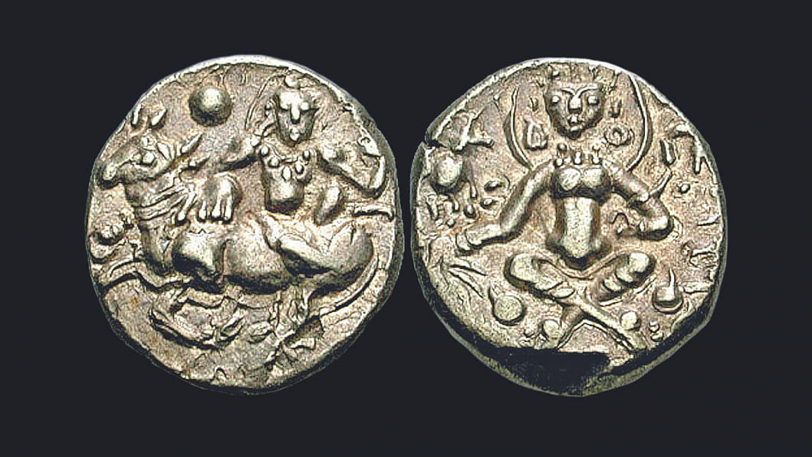
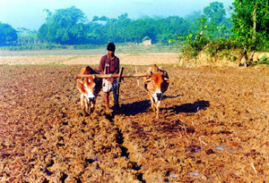
Economical Influence in Medieval Bengal
During Muslim rule, the agricultural system of Bengal became self-sufficient, and agricultural production as well as the number of products multiplied. The development and growth of the textile industry meet the local demand. During this time, the use of metal industries such as iron and copper increased, and the two-headed sword of Bengal became famous in the subcontinent. The government introduced a welfare control system in the market system. Economic dynamism came through gold and silver coins. The cottage industry was widespread in rural areas. During the Muslim rule, Bengal’s trade relations with different parts of the subcontinent, along with the Arab world and Europe, were strengthened, which changed the economy of Bengal. At the beginning of the Muslim period, rulers descent built long dams in Lakhnauti, the capital of Bengal, which benefited many of the local people.

Slide 19
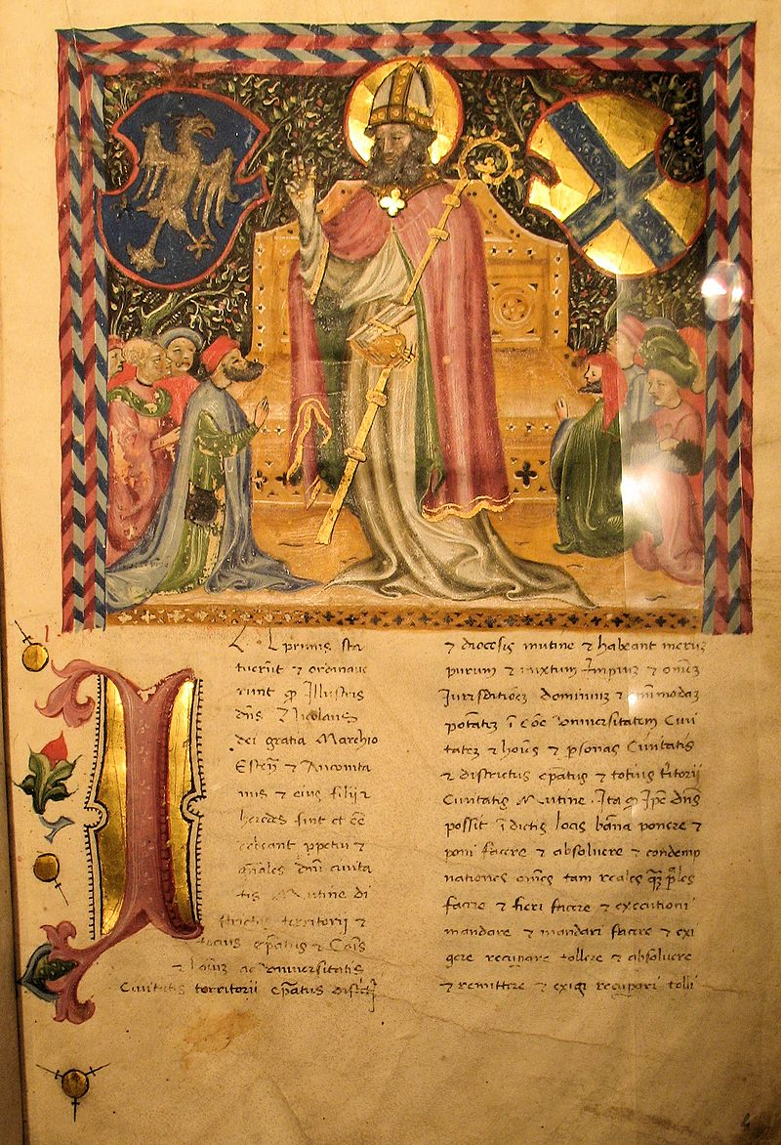
EDUCATIONAL PROGRESS AND DEVELOPMENT OF BENGALI LANGUAGE AND LITERATURE
Bengali had an excellent experience in education, language, and literature during the Muslim rule. Inspired by Islam rulers took various steps to spread education in Bengal, like the Muslim rulers of Delhi. From the beginning of the establishment of Muslim rule in Bengal, Bakhtiyar Khalji and his successors built numerous madrasas and mosques. One of the characteristics of the Muslim rulers was that during their rule, they established famous mosques and popular madrasas and took care of them and paid for them. Like other educational institutions in other parts of the Muslim world, the education system of madrasas in Bengal was quite advanced. During the Sultanate period, considering the political and economic needs of the Muslims, large towns and cities sprang up in Bengal. Scholars used to teach in educational institutions, and students from different subcontinents came here for education. The scholars associated with the Department of Education did not accept the exchange of education, they provided free education to the students, and the scholars accepted teaching as human service and a respected. The educational institutions established by the Muslim Sultans played a significant role in qualifying the ordinary locals to run the state and build an enlightened society. Muslim rulers, Sufis, and administrators were educated, and they played an essential role in spreading education.

Slide 20
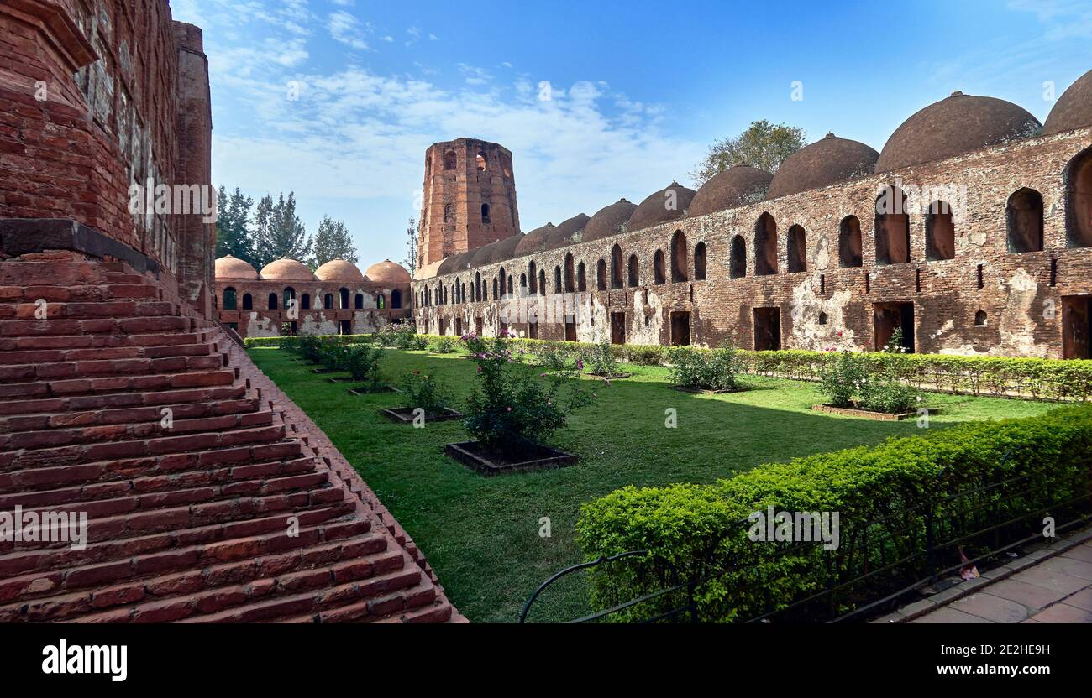
CULTURAL INFLUENCE IN MEDIEVAL BENGAL
Muslims brought their famous culture and tradition to Bengal, and architecture was one of them. After the Muslim conquest, many architects came to Bengal from Central Asia and North India and designed their new style of traditional Islamic architecture. Architecture flourished here long before the arrival of Muslims in Bengal, but after their arrival, a unique local architectural style developed in tandem with the Persian-Arabian style. The main elements of architecture used as connecting materials were various high-quality materials, including lime, sand, and suki. They used beautiful pictures of nature, herbs, waterfalls, rivers, hills, etc., on the walls of the aesthetic buildings. Architects of the Muslim period used to introduce cornices in the construction of buildings and curved lines. The Role of Muslims in the Socio-Cultural Formation of Bengal during the Sultanate Period on the walls of forts. Mosques and tombs were the most notable in Muslim architecture.

Slide 21
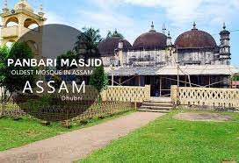
ARCHITECTURE
A majority of the Bengal Sultanate's mint towns and surviving structures are found in Bangladesh. The Indian state of West Bengal is home to two of the sultanate's former capitals Gaur and Pandua, as well as several notable structures including a watchtower and fortified walls. The oldest mosque in the Indian state of Assam dates from the Bengal Sultanate. A 15th-century sultanate-era mosque lies in ruins and covered in Myanmar's Rakhine State.

Slide 22
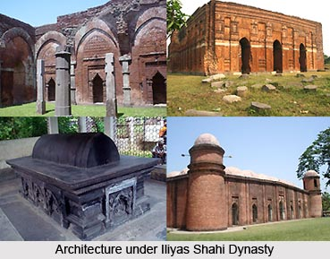
ARCHITECTURE
Urban architecture - Cities in the Bengal Sultanate had stately medieval architecture, particularly in the royal capitals of Gaur and Pandua. In 1500, the royal capital of Gaur had the fifth-largest urban population in the world after Beijing, Vijayanagar, Cairo and Canton. It had a population of 200,000 (at the time, the global population is estimated to have ranged between 400 and 500 million). The Portuguese historian Castenhada de Lopez described houses in Gaur as being one-storeyed with ornamental floor tiles, courtyards and gardens. The city had a citadel, durbar, watchtowers, canals, bridges, large gateways, and a city wall.
The royal palace was divided into three compartments. The first compartment was the royal court. The second was the living quarter of the Sultan. The third was the harem. A high wall enclosed the palace. A moat surrounded the palace on three sides and was connected to the Ganges. The city of Pandua developed from a small hamlet into a military garrison. It included imperial mosques and mausolea.
Urban architecture in the Bengal Sultanate was based on Arab, Bengali, Persian, Indo-Turkish, and Byzantine influences. The Bengal roofs began appearing in concrete forms during the 15th century. These roofs were later widely replicated in the Mughal Empire and the Rajput kingdoms of the northwestern Indian subcontinent.

Slide 23
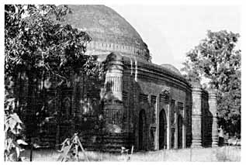
ARCHITECTURE
Mosque architecture - According to Perween Hasan, the mosques of the Bengal Sultanate have several common features, including pointed arches, multiple mihrabs, engaged corner towers, and terracotta and stone decoration.
In particular, the art of the mihrab is meticulous and unique to Bengal's mosque architecture. Mosques were either rectangular and multi-domed or square and single-domed. The large number of mosques built during the Bengal Sultanate indicates the rapidity with which the local population converted to Islam.

Slide 24
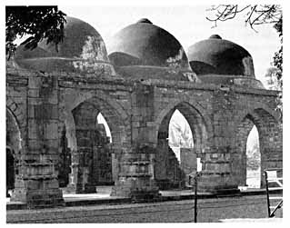
ARCHITECTURE
The period between 1450 and 1550 was an intensive mosque building era. These mosques dotted the countryside, ranged from small to medium sizes and were used for daily devotion. Ponds were often located beside a mosque. Arabic inscriptions in the mosques often include the name of the patron or builder.
The buildings were made of brick or stone. The brick mosque with terracotta decoration represented a grand structure in the Bengal Sultanate. They were often the gift of a wealthy patron and the fruit of extraordinary effort, which would not be found in every Muslim neighborhood.

Slide 25
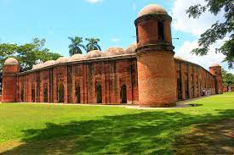
ARCHITECTURE
The highest concentration of mosques from the Bengal Sultanate can be found in the North Bengal regions of Bangladesh and Indian West Bengal. A mosque city developed near the southwestern Bengali Sundarbans forest as a result of the patronization of Governor Khan Jahan Ali. In 1985, UNESCO designated the city as a World Heritage Site. In central areas, the Pathrail Mosque in Faridpur is one of the best-preserved sultanate-era structures.
In the northeast, the Shahi Masjid in Sylhet is a well-preserved structure of the Bengal Sultanate. In the northeastern Indian state of Assam, the Panbari Mosque was built during the reign of Sultan Alauddin Hussain Shah. Other mosques can be found in coastal areas of West Bengal and parts of Bihar, such as the Sayed Jamaluddin Mosque. In the southeast, the Santikan Mosque (built in the 1430s) stands in ruins in Rakhine State (formerly Arakan) of Myanmar (formerly Burma).

Slide 26
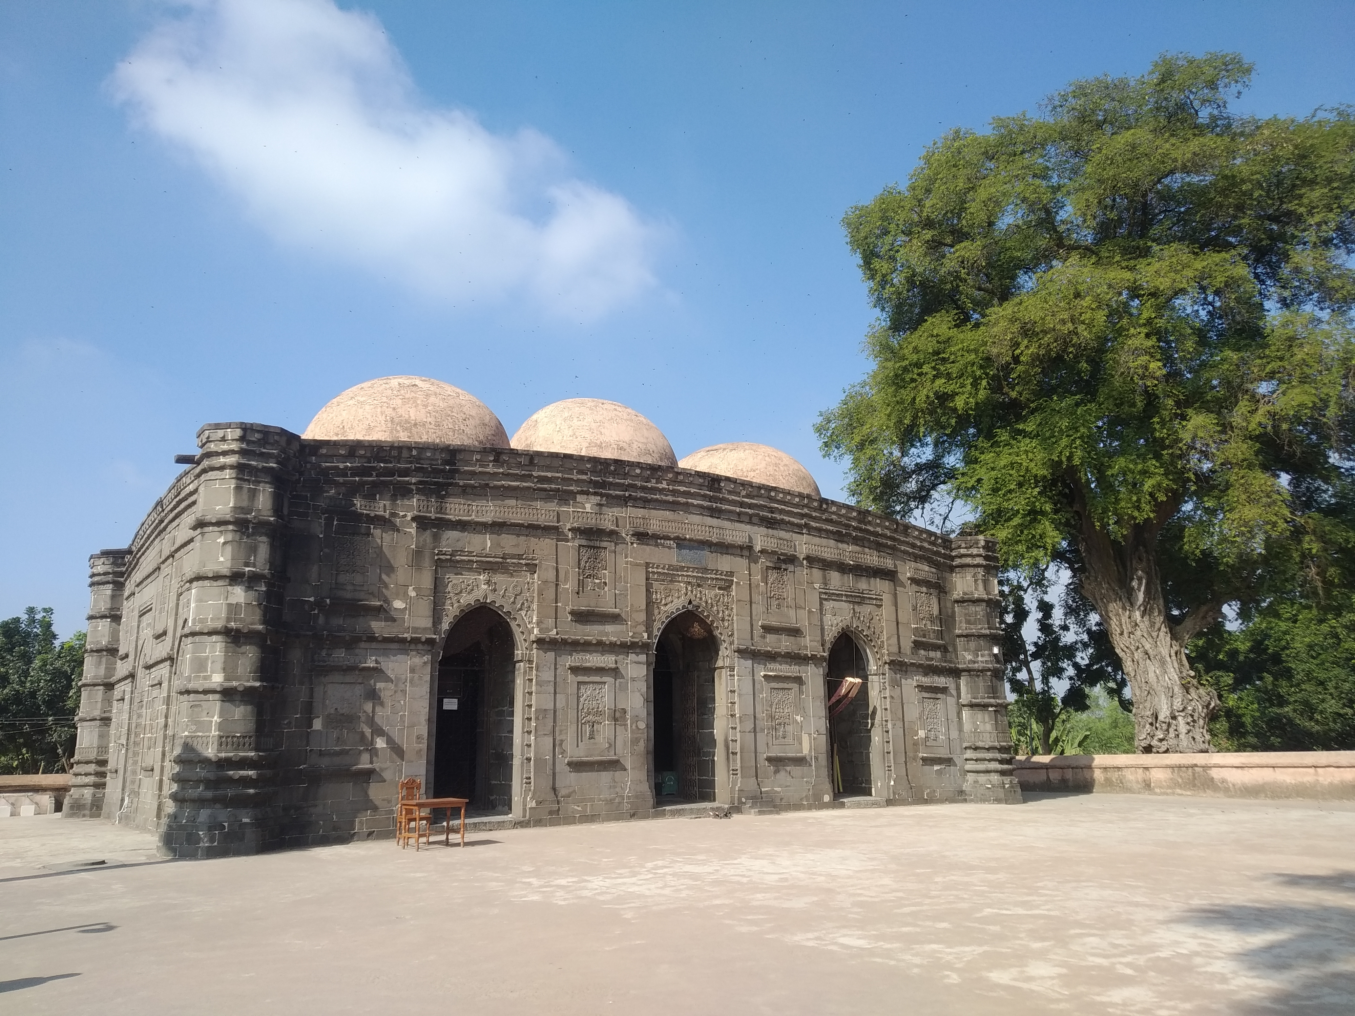
ARCHITECTURE
Imperial mosques had an in-built throne for the Sultan. These thrones are termed as Badshah-e-Takht (King's Throne). The Sultans sat on the elevated throne and addressed his subjects below. The Sultans also administered justice and managed government affairs while sitting on these thrones. Mosques served as royal courts. Mosques across the Bengal Sultanate had these thrones. The Sultans traveled from one town to another and hosted royal court activities in mosques with a Badshah-e-Takht. The Badshah-e-Takht in Kusumba Mosque is heavily decorated with a designed Mihrab.

Slide 27
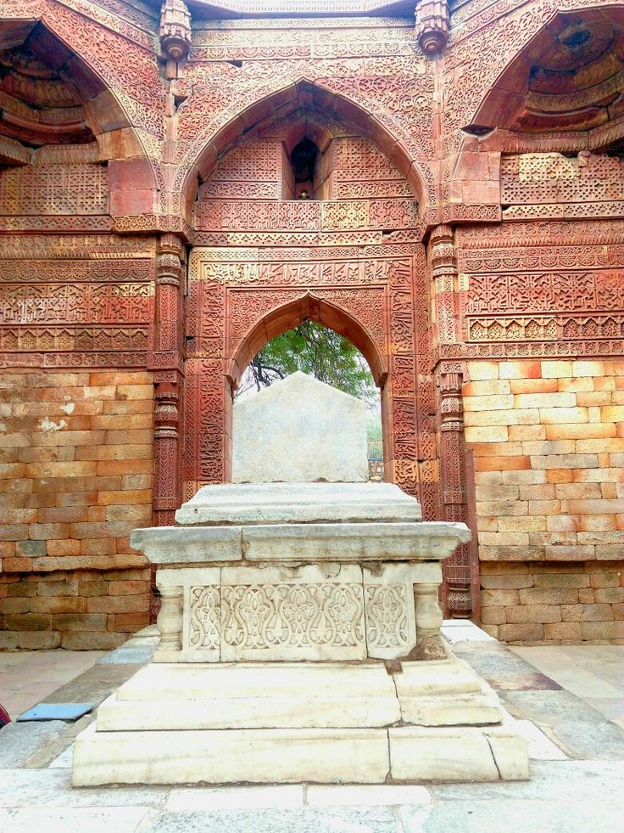
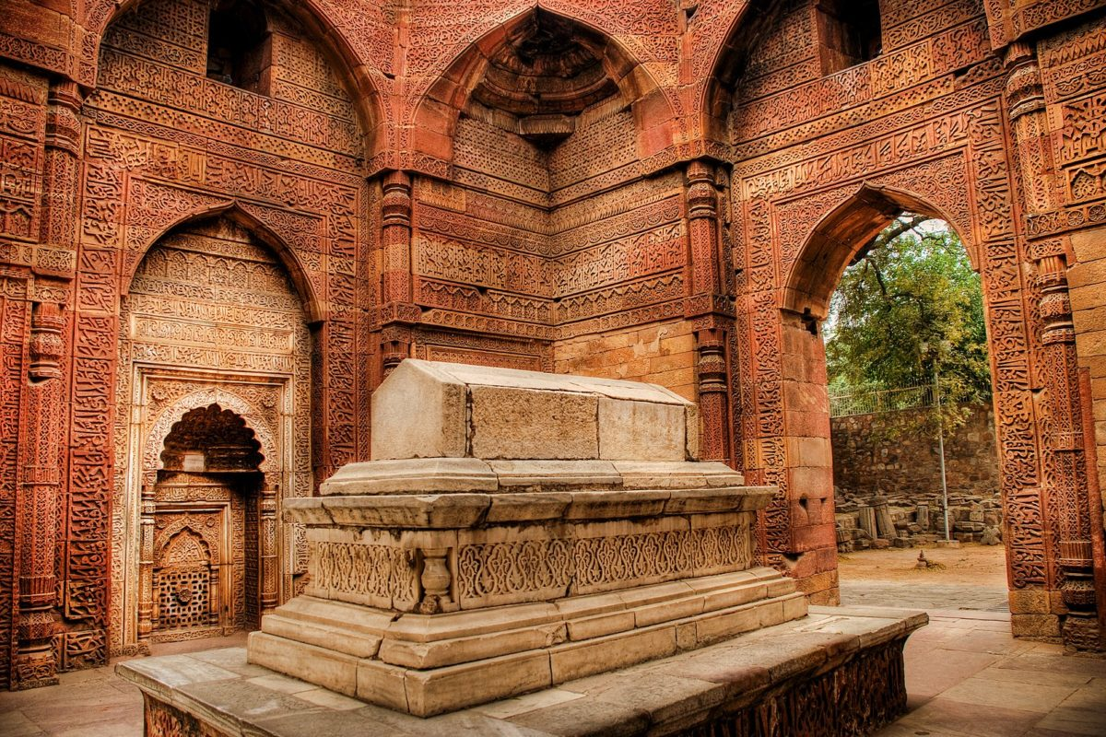
ARCHITECTURE
Tomb architecture - Pointed arches and Engaged corner tower Terracotta a Bengal roof in in Nine Dome Mosque of Choto Sona Mosque Khania Dighi Mosque Mausoleums of the Bengal Sultanate are an important architectural hallmark. Initially, it was based on Iranian models, such as the Tomb of Cyrus. Sultan Ghiyasuddin Azam Shah in Sonargaon has features similar to the architecture of Adina Mosque built by his father Sultan Sikandar Shah. An indigenous Islamic mausolea style developed with the Eklakhi Mausoleum, which is the royal tomb chamber of Sultan Jalaluddin Muhammad Shah.

Slide 28
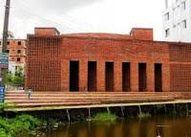
ARCHITECTURE
Legacy - The architecture of the Bengal Sultanate has influenced modern architecture in Bangladesh. The sultanate era inspired the Baitur Rauf Mosque, which won the Aga Khan Award for Architecture in 2016.

Slide 29


